Slide 1
WORK ALLOCATOR
Submitted by
P BALA [RA1611003040198]
SAEM AHMER [RA1611003040251]
RAHUL SUBHAGAN [RA1611003040210]

Slide 2
WHAT IS WORK ALLOCATOR?
IT IS BASICALLY AN EMPLOYEE WORK MANAGEMENT SYSTEM.THIS IS IDEALISED TO CREATE A SMOOTH WORKING ENVIRONMENT IN A BUSY SCHEDULED COMPANY.THROUGH THIS TOOL A TOP DESIGNATED MANAGER COULD MANAGE ALL THE EMPLOYEE ON WORK ALLOCATION,SUPERVISION AND MOST IMPORTANTLY TIME MANAGEMENT .SO BASICALLY A MANAGER COULD KEEP AN EYE ON THE STATUS OF ALL ONGOING PROJECTS UNDER HIM.WORK ALLOCATION WILL BE PURELY BASED ON THE EMPLOYEES SPECIALISATION AND EXPERTISE IN THEIR RESPECTED FIELD.

Slide 3
OJECTIVES
TO CREATE A SYSTEM TO MANAGE WORK ALLOCATION AND SUPERVISION
TO HELP CREATE A CLEAR AND COMPREHENSIVE VIEW IN THE WORKING ENVIRONMENT
TO MAINTAIN AN INVOLVEMENT OF EVERY INDIVIDUAL OF THE COMPANY
TO IMPROVE TIME MANGEMENT BY REDUCING ONE TO ONE MEETINGS

Slide 4
LANGUAGES & ENVIRONMENTS REQUIRED
JAVA[JDK & JRE] TO IMPLEMENT JDBC
SQL FOR DATABASE MANGEMENT

Slide 5
HOW IS IT BETTER?
INDIVIDUAL LOGIN SYSTEM
MAINTAINS HIERARCHY BY ALLOWING TOP DESIGNATED MANAGERS TO SUPERVISE EMPLOYEES UNDER HIM
EMPLOYEES OF THE SAME LEVEL CANNOT PEEK ON OTHERS WORK

Slide 6
Java Swing
Swing is a GUI widget toolkit for Java. It is part of Oracle's Java Foundation Classes (JFC) – an API for providing a graphical user interface (GUI) for Java programs.
Swing was developed to provide a more sophisticated set of GUI components than the earlier Abstract Window Toolkit (AWT). Swing provides a look and feel that emulates the look and feel of several platforms, and also supports a pluggable look and feel that allows applications to have a look and feel unrelated to the underlying platform. It has more powerful and flexible components than AWT. In addition to familiar components such as buttons, check boxes and labels, Swing provides several advanced components such as tabbed panel, scroll panes, trees, tables, and lists.

Slide 7
JFrames
The whole frontend of our system application is made by the help of JFRAMES.
This involves the following frames:-
Login Page(Employee and Manager login)
Manager Frame where work will be assigned to the employees
Employee Frame where the employee can view the assigned project and submit his work.

Slide 8
XAMPP
XAMPP is a free and open source cross-platform web server solution stack package developed by Apache Friends, consisting mainly of the Apache HTTP Server, database, and interpreters for scripts written in the PHP and Perl programming languages.
XAMPP stands for Cross-Platform (X), Apache (A ), MariaDB (M), PHP (P) and Perl (P). It is a simple, lightweight Apache distribution that makes it extremely easy for developers to create a local web server for testing and deployment purposes. Everything needed to set up a web server – server application (Apache), database, and scripting language (PHP) – is included in an extractable file. XAMPP is also cross-platform, which means it works equally well on Linux, Mac and Windows. Since most actual web server deployments use the same components as XAMPP, it makes transitioning from a local test server to a live server extremely easy as well.

Slide 9
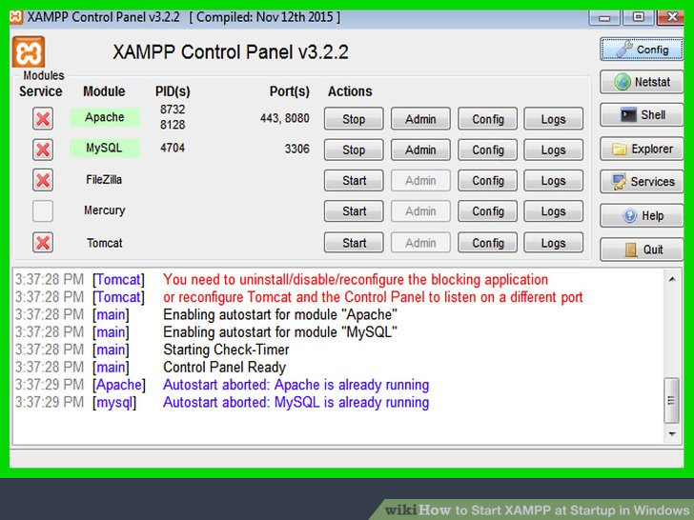
XAMPP

Slide 10
phpMyAdmin
phpMyAdmin is a free and open source administration tool for MySQL and MariaDb. As a portable web application written primarily in PHP, it has become one of the most popular MySQL administration tools, especially for web hosting services.
For our project Work Allocator we have used MySQL database by the help of phpmyadmin

Slide 11
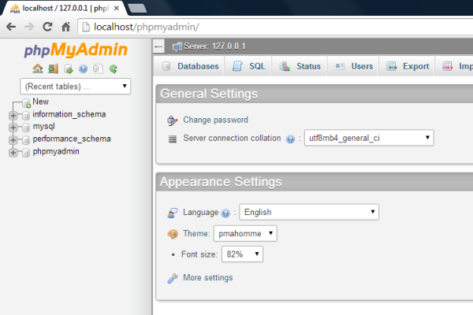
phpMyAdmin

Slide 12
Libraries
package mysql;
import java.sql.*;
import java.awt.BorderLayout;
import java.awt.Dimension;
import java.awt.EventQueue;
import javax.swing.JFrame;
import javax.swing.JPanel;
import javax.swing.border.EmptyBorder;
import javax.swing.JTextField;
import javax.swing.JLabel;
import javax.swing.JOptionPane;

Slide 13
Database Connectivity
JButton btnLogin = new JButton("Login");
btnLogin.setBounds(25, 258, 97, 35);
btnLogin.addActionListener(new ActionListener() {
public void actionPerformed( ActionEvent arg0) {
try {
Class.forName("com.mysql.jdbc.Driver");
Connection con= DriverManager.getConnection("jdbc:mysql://localhost:3306/data1","root","");
Statement stmt=con.createStatement();
String sql="Select * from table1 where username='"+user.getText()+"' and password='"+pass.getText().toString()+"'";
ResultSet rs= stmt.executeQuery(sql);

Slide 14
if(rs.next())
{
JOptionPane.showMessageDialog(null, "Login Succesful");
sec s=new sec();
s.setVisible(true);
}
else
JOptionPane.showMessageDialog(null,"Incorrect Username and Password...");
con.close();
}catch(Exception e) {System.out.print(e);}

Slide 15
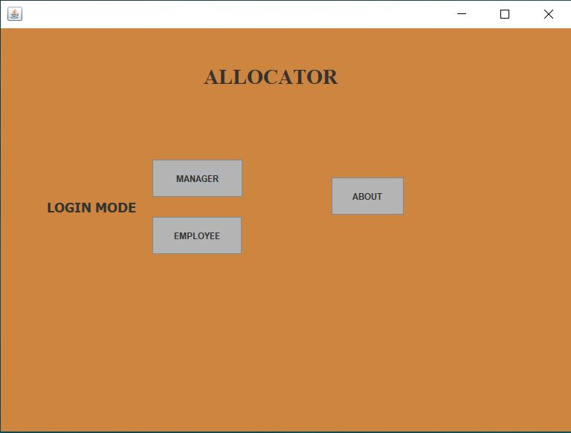
Final output screenshots

Slide 16
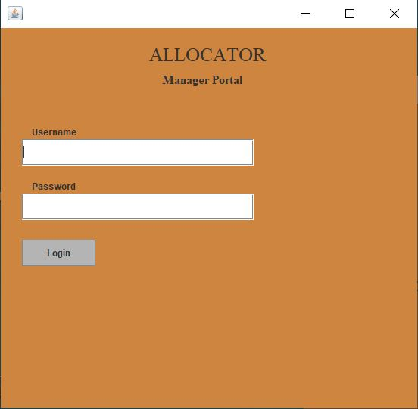
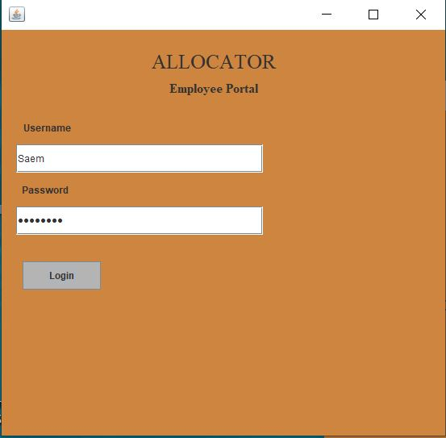

Slide 17
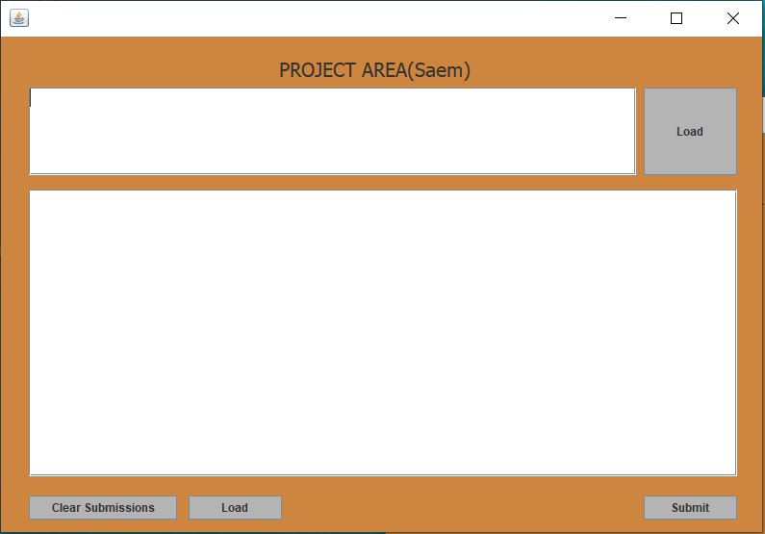
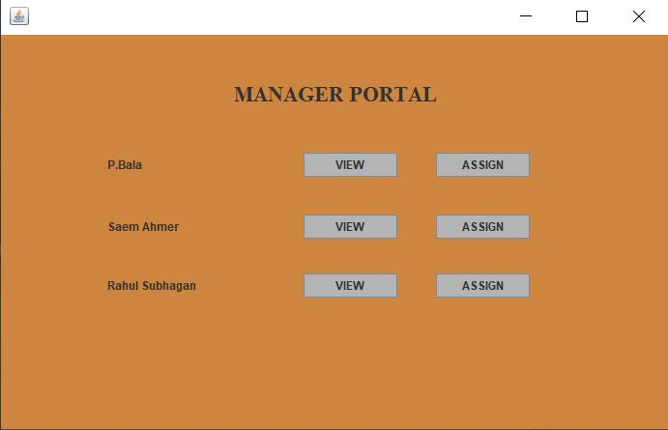

Slide 18
THANK YOU

